Slide 1
WEB Technologies (CS-566)
LECTURE # 7– Lists in HTML

Slide 2
Outline
List
Lists in HTML
Types of Lists with their attributes
Nested list is HTML

Slide 3
What is list

Slide 4
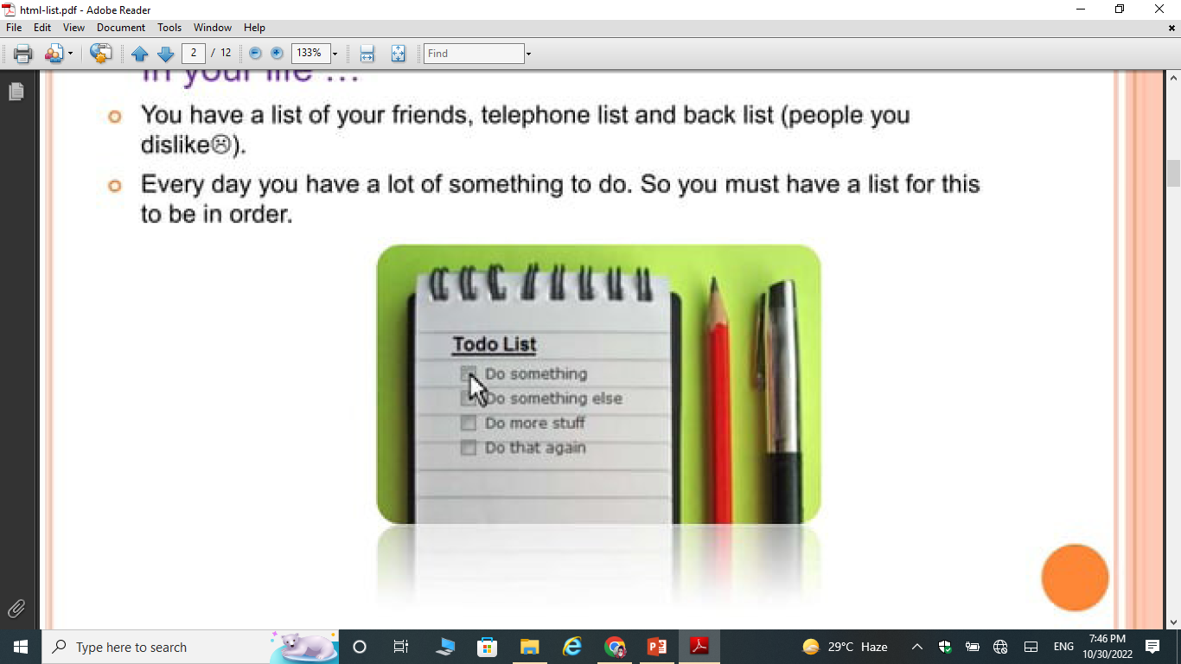
What is List
In Your Life…
You have a list of your friends, telephone list, block list(people you dislike)
Everyday you have a lot of something to do. So you must have a list for this to be in order.

Slide 5
What is list
In HTML…
HTML Lists are used to specify lists of information. All lists may contain one or more list elements.
List will be appear as vertical or horizontal.

Slide 6
Types of in HTML

Slide 7
Types of lists
Ordered List or Numbered List (ol)
Unordered List or Bulleted List (ul)
Description List or Definition List (dl)

Slide 8
ordered list
In the ordered HTML lists, all the list items are marked with numbers by default. It is known as numbered list also. The ordered list starts with <ol> tag and the list items start with <li> tag.
Example:
<ol>
<li>Aries</li>
<li>Bingo</li>
<li>Leo</li>
<li>Oracle</li>
</ol>
Output:
1. Aries
2. Bingo
3. Leo
4. Oracle

Slide 9
Format of OL
We can use ordered list to represent items either in numerical order format or alphabetical order format, or any format where an order is emphasized. There can be different types of numbered list:
Numeric Number (1, 2, 3) By Default, Ascending Order
Capital Roman Number (I II III)
Small Roman Number (i ii iii)
Capital Alphabet (A B C)
Small Alphabet (a b c)

Slide 10
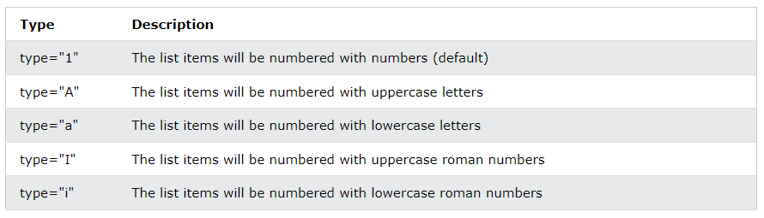
Attributes of OL
Type:
The type attribute of the <ol> tag, defines the type of the list item marker.

Slide 11
Example
<ol type="I">
<li>HTML</li>
<li>Java</li>
<li>JavaScript</li>
<li>SQL</li>
</ol>
<ol type="A">
<li>HTML</li>
<li>Java</li>
<li>JavaScript</li>
<li>SQL</li>
</ol>
Output:
HTML
Java
JavaScript
SQL
Output:
HTML
Java
JavaScript
SQL

Slide 12
Cont…
Control List Counting
By default, an ordered list will start counting from 1. If you want to start counting from a specified number, you can use the start attribute.
<ol type="I" start="5">
<li>HTML</li>
<li>Java</li>
<li>JavaScript</li>
<li>SQL</li>
</ol>
Output:
HTML
Java
JavaScript
SQL

Slide 13
Cont…
Reversed
It will show the order of list in descending order.
<ol reversed>
<li>HTML</li>
<li>Java</li>
<li>JavaScript</li>
<li>SQL</li>
</ol>
Output:
4. HTML
3. Java
2. JavaScript
1. SQL

Slide 14
Unordered list
In HTML Unordered list, all the list items are marked with bullets. It is also known as bulleted list also. The Unordered list starts with <ul> tag and list items start with the <li> tag.
Example:
<ul>
<li>Aries</li>
<li>Bingo</li>
<li>Leo</li>
<li>Oracle</li>
</ul>
Output:
Aries
Bingo
Leo
Oracle

Slide 15
Format of UL
We can use unordered list where we do not need to display items in any particular order. The HTML <ul> tag is used for the unordered list. There can be 4 types of bulleted list:
Disc (Default)
Circle
Square
None

Slide 16
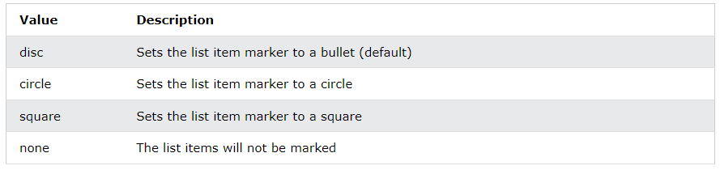
Attributes of UL
Style:
The style attribute of the <ol> tag, defines the type of the list item marker.

Slide 17
Example
<ul style="list-style-type:circle;“>
<li>HTML</li>
<li>Java</li>
<li>JavaScript</li>
<li>SQL</li>
</ul>
<ul style="list-style-type: square;">
<li>HTML</li>
<li>Java</li>
<li>JavaScript</li>
<li>SQL</li>
</ul>
Output:
HTML
Java
JavaScript
SQL
Output:
HTML
Java
JavaScript
SQL

Slide 18
Description List or definition list
A description list is a list of terms, with a description of each term.
The description list is very appropriate when you want to present glossary, list of terms or other name-value list.
The HTML definition list contains following three tags:
<dl> tag defines the start of the list.
<dt> tag defines a term.
<dd> tag defines the term definition (description).

Slide 19
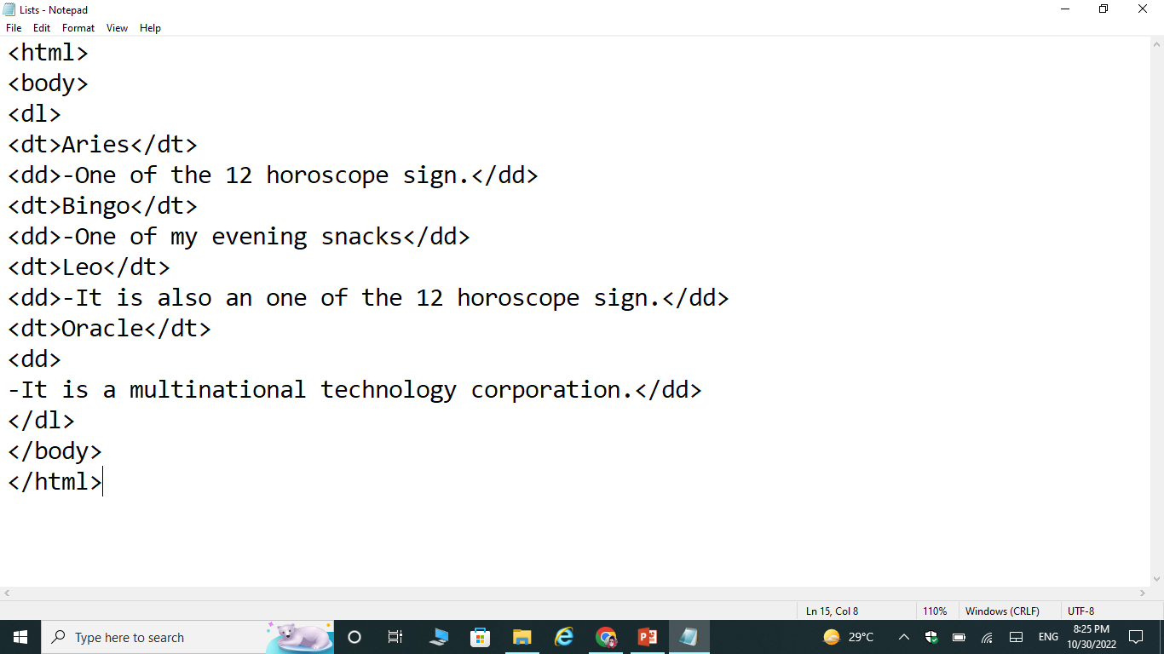
Example

Slide 20
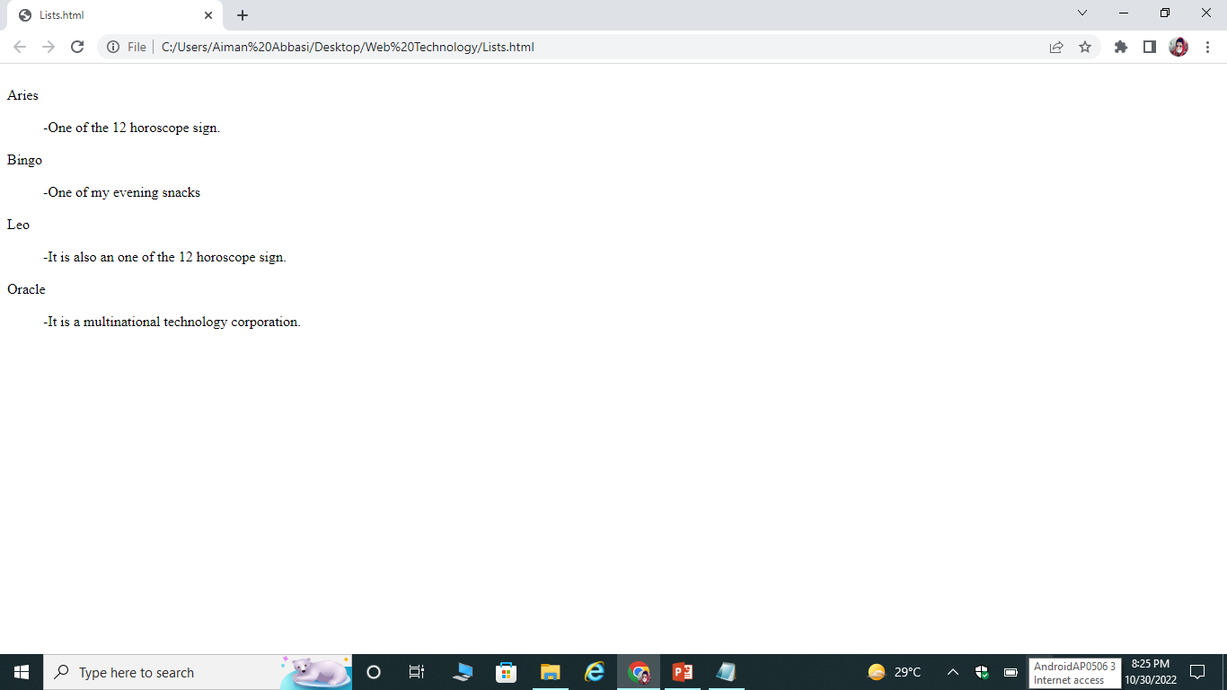
Cont…

Slide 21
Nested List in HTML

Slide 22
Nested list
A list within another list is termed as nested list. If you want a bullet list inside a numbered list then such type of list will called as nested list.

Slide 23
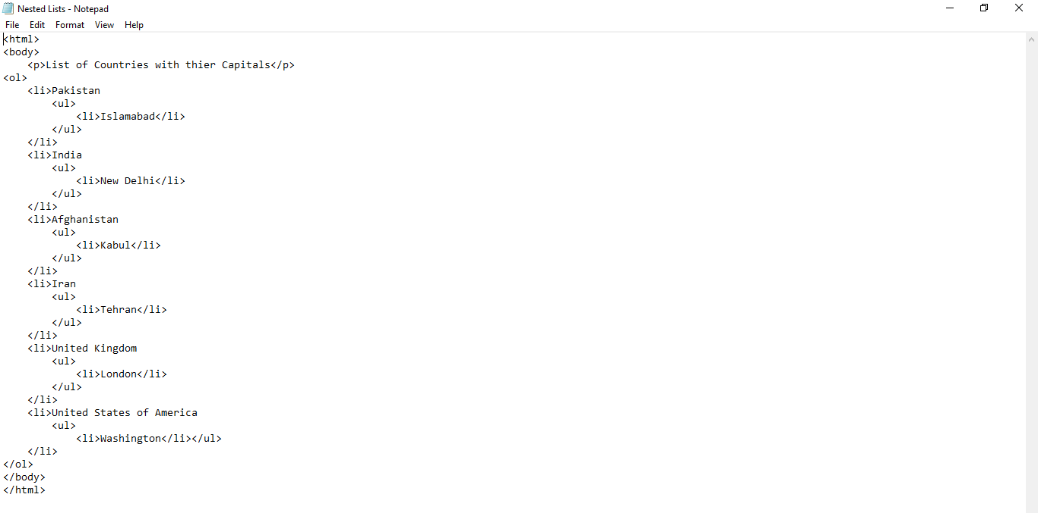
Example

Slide 24
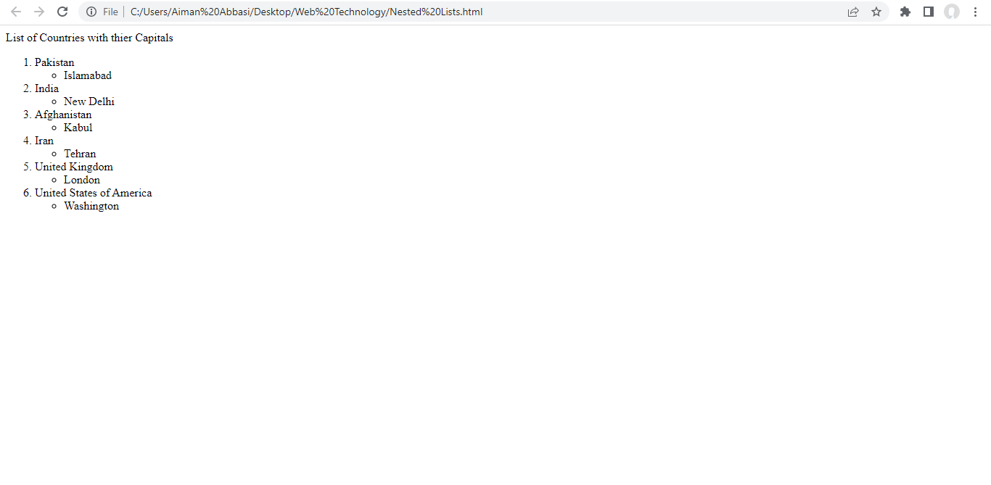
Cont…

Slide 25
Exercise Questions

Slide 26
Exercise Questions
Practice adding ordered and unordered lists in your web page.
Practice adding nested lists in your web page.

